Slide 1
Sep 14th, 2024

Slide 2
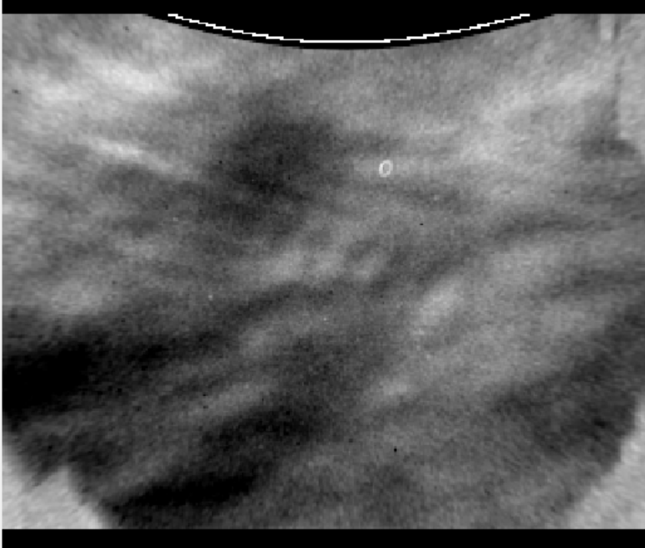
Date: 14-Sep
Img#: 121
Time: 5:27
General Direction: SW
Direction from FF: 196
Horizontal Wavelength: 13 km
Vertical Wavelength: 40 km
Phase Speed (m/s): 41
T’ (K): 1.3
MF(m^2/s^2): 12

Slide 3
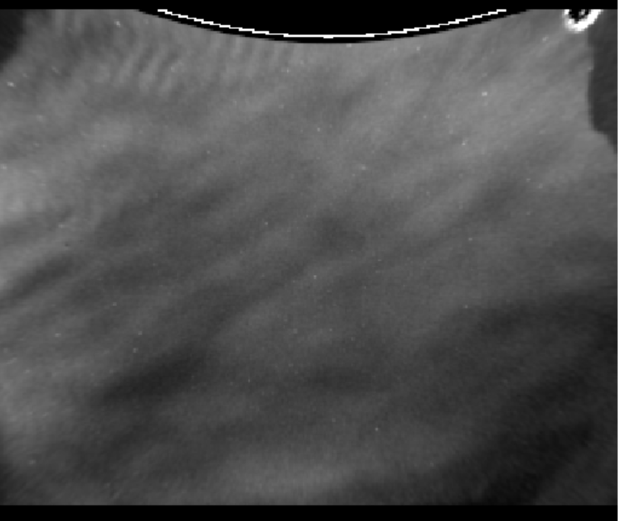
Date: 14-Sep
Img#: 312
Time: 7:13
General Direction: SW
Direction from FF: 156
Horizontal Wavelength: 21 km
Vertical Wavelength: 51 km
Phase Speed (m/s): 63
T’ (K): 1.1
MF(m^2/s^2): 7.0

Slide 4
Nov 7th, 2024

Slide 5
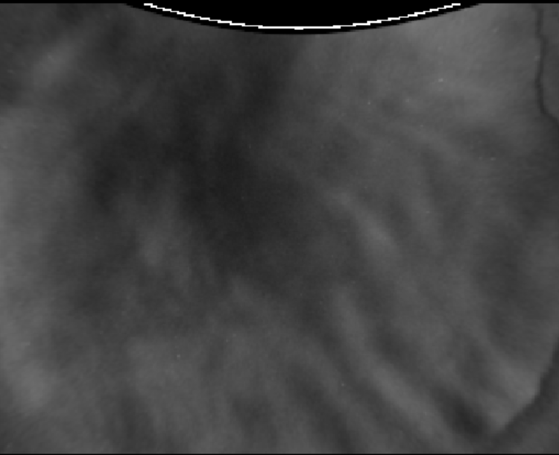
Date: 7-Nov
Img#: 126
Time: 2:06
General Direction: SW
Direction from FF: 225
Horizontal Wavelength: 23 km
Vertical Wavelength: 53 km
Phase Speed (m/s): 49
T’ (K): 1.7
MF(m^2/s^2): 22

Slide 6
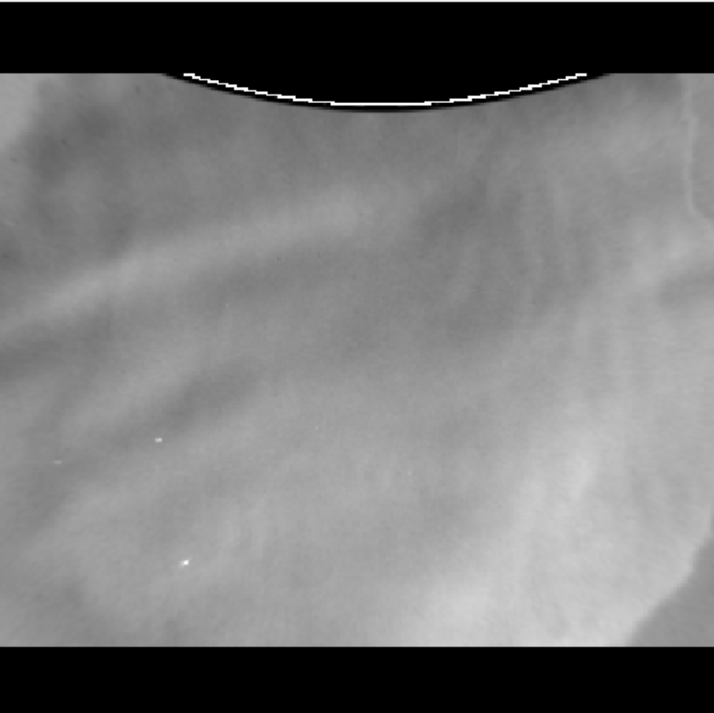
Date: 7-Nov
Img#: 1176
Time: 11:50
General Direction: N
Direction from FF: 326
Horizontal Wavelength: 30 km
Vertical Wavelength: 31 km
Phase Speed (m/s): 66
T’ (K): 1.6
MF(m^2/s^2): 7.6

Slide 7
Going Forward
Is there a way to add movies to this presentation?
I can start analyzing waves on more dates, or analyze Keograms with Connor.

